Slide 1

Università degli Studi di Napoli “PARTHENOPE"
Dipartimento di Scienze e Tecnologie
Corso di Laurea Magistrale in Informatica Applicata
Architettura e Programmazione di Reti Avanzate
PebbleJS on Browser
Prof. R. Montella
Alessandro Longobardi 0120/119
Marco Saviano 0120/114

Slide 2
Contents
Introduction
Pebble.js
Cloud Pebble
Pebble Emulator
PebbleJS on Browser
Conclusion and Future Works
References & Contacts

Slide 3
1- Introduction
The aim of our work is to use Pebble.js Javascript framework to create apps running on browser for every type of devices (desktop, tablet, smartphone etc…)
Tools used:
Pebble.js
CloudPebble
PebbleEmulator
JQWidgets

Slide 4
2-Pebble.js
It is a Javascript Framework that allows writing Pebble applications in JavaScript
Pebble.js follows modern JavaScript best practices

Slide 5
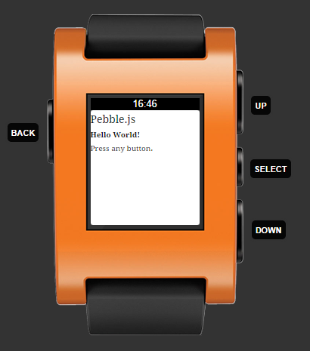
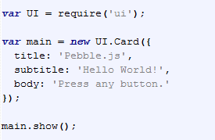
2-Pebble.js Get Started - Card
Notes:
1) Call $require(′ui′)$ to load the UI module and start building user interfaces
The UI framework contains all the classes needed to build the user interface of your Pebble applications and interact with user
2) The basic block to build user interface is the $Card$
A $Card$is a type of Window that allows you to display a title, a subtitle, an image and a body on the screen of Pebble
Just like any window, you can initialize a Card by passing an object to the constructor or by calling accessors to change the properties.
3) After creating a card window, push it onto the screen with the $show()$method.
4) To interact with the users, use the buttons or the accelerometer. Add callbacks to a window with the $.on()$method
5) Making HTTP connections is very easy with the included ajax library.

Slide 6
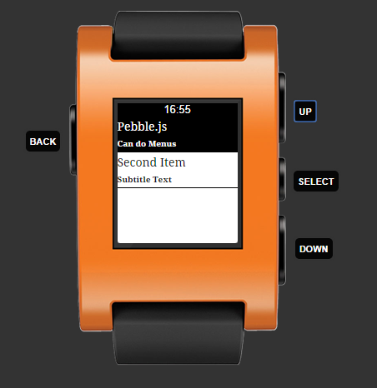
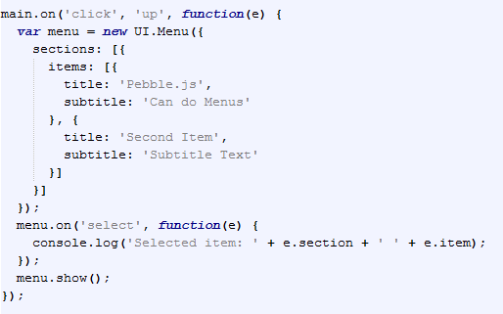
2-Pebble.js Get Started - Menu

Slide 7
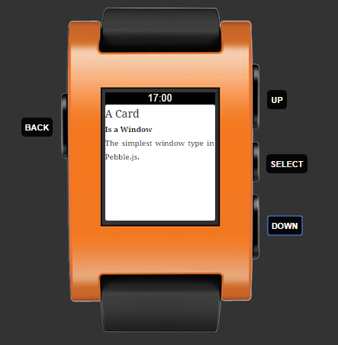
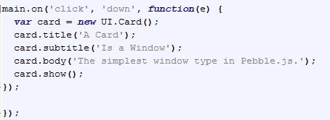
2-Pebble.js Get Started – Button Bind

Slide 8
3-CloudPebble
It is a web-based IDE for Pebble development
Created by Katharine Berry
It provides several useful features for new Pebble developers, including online compilation, Github integration, and a GUI-based app configuration panel
Using CloudPebble means that users are not required to download, install, and configure the Pebble SDK on their local computer

Slide 9
4-Pebble Emulator
Developers can create apps using Pebble.js and watch how they work on browser using CloudPebble on Steroids and Pebble Emulator
For more details:
https://students.uniparthenope.it/~0124000391/pebble/

Slide 10
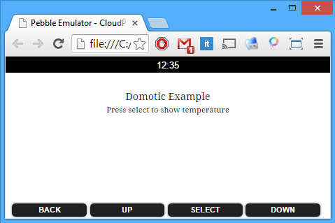
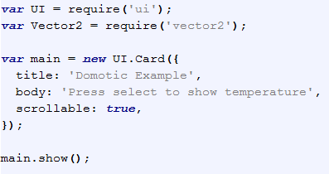
5-PebbleJS on Browser Run on Browser
In our Framework, Pebble.js apps run on browser

Slide 11
5-PebbleJS on Browser Custom Card - WTemp
We add a new UI object in Pebble.js, WTemp (Widget Temperature), a Card that shows temperature of a city passed as parameter
HTTP connections are very easy with the included ajax library in JavaScript

Slide 12
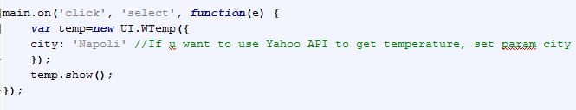
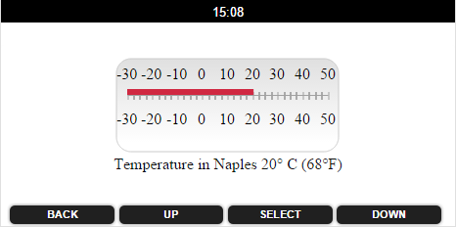
5-PebbleJS on Browser Custom Card - WTemp

Slide 13
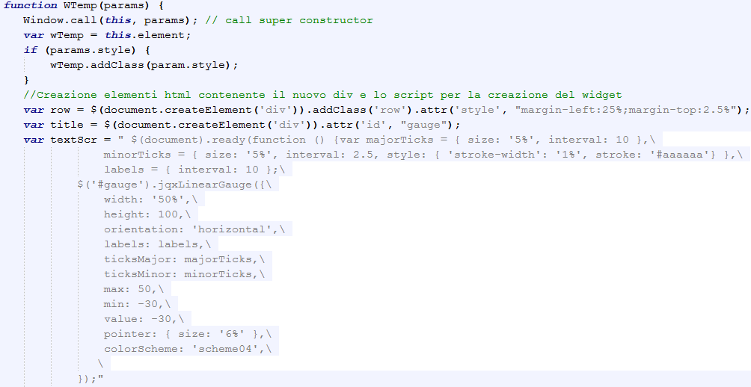
5-PebbleJS on Browser WTemp

Slide 14
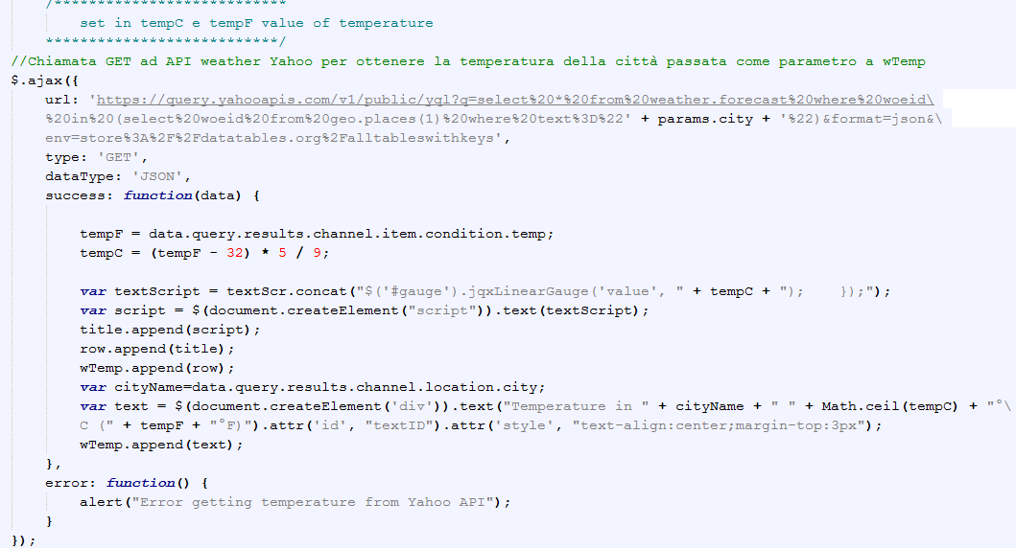
5-PebbleJS on Browser WTemp

Slide 15
6 – Conclusion and Future Works
Create apps with simple UI
Simplicity of Pebble.js
Perfect for different sizes of screen (tablet, smartphone, desktop)
Internet of things apps (domotic, nautic etc..)
Add other UI Objects
Create custom layout for specific applications

Slide 16
References & Contacts
https://web.uniparthenope.it/
http://pebble.github.io/pebblejs/
https://students.uniparthenope.it/~0124000391/pebble/
http://www.jqwidgets.com/
https://developer.yahoo.com/weather/
Marco Saviano – marco.saviano.89@gmail.com
Alessandro Longobardi – alessandrolongobardi89@gmail.com

Slide 17
The End
Thank you for the attention
Marco Saviano
Alessandro Longobardi

